Slide 1
Segmentation of Vessels in Retinal Images
Team 6
Team Members: Shiyu Wang, Enhao He, Jiacheng Ma, Joe Wang

Slide 2
1 Introduction

Slide 3
TODO

Slide 4
2 Methods

Slide 5
Methods & Metrics
K-means Clustering
TODO
Accuracy
Sensitivity
Specificity
F1-score
The area under the ROC curve (AUC)

Slide 6
3 Results

Slide 7
3-1

Slide 10
3-2

Slide 13
3-3

Slide 16
3-4 K-means Clustering

Slide 17
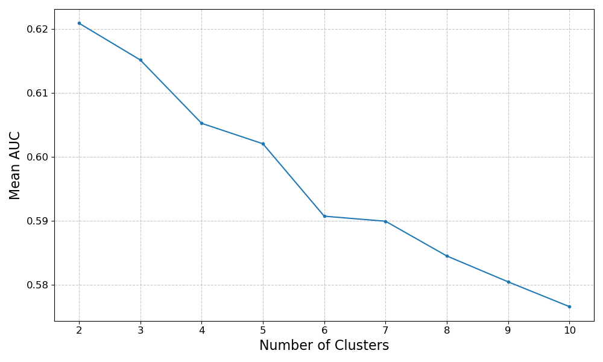
Find the Best “n_clusters”

Slide 18
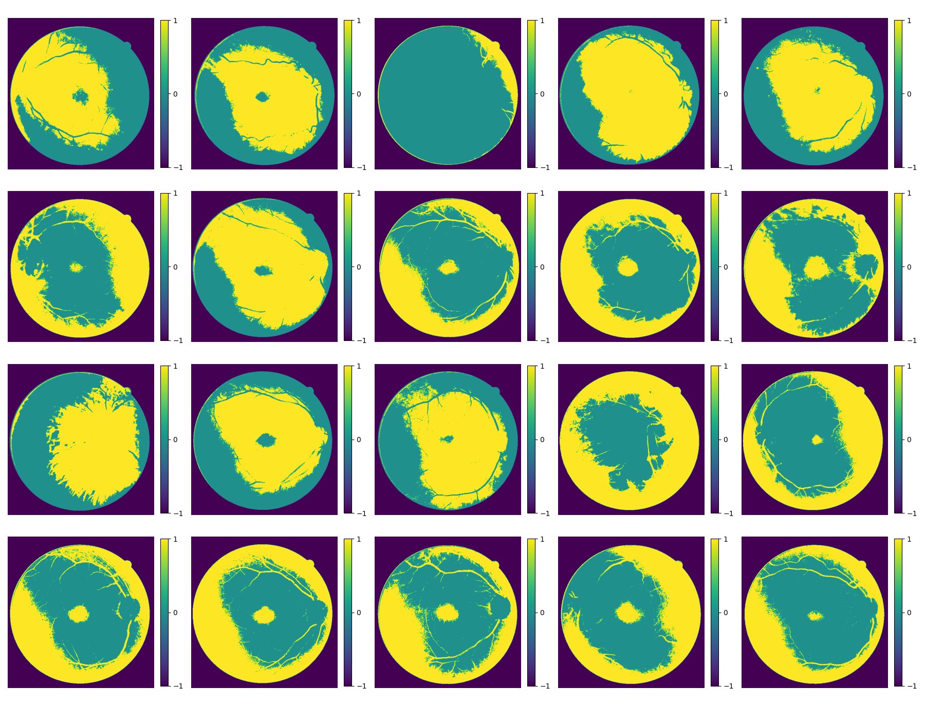

Slide 19
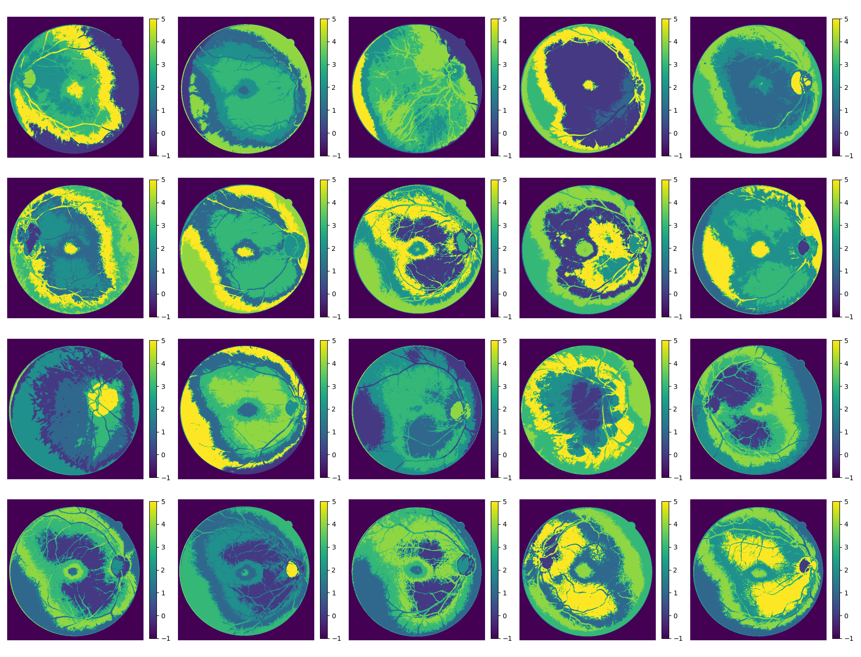

Slide 20
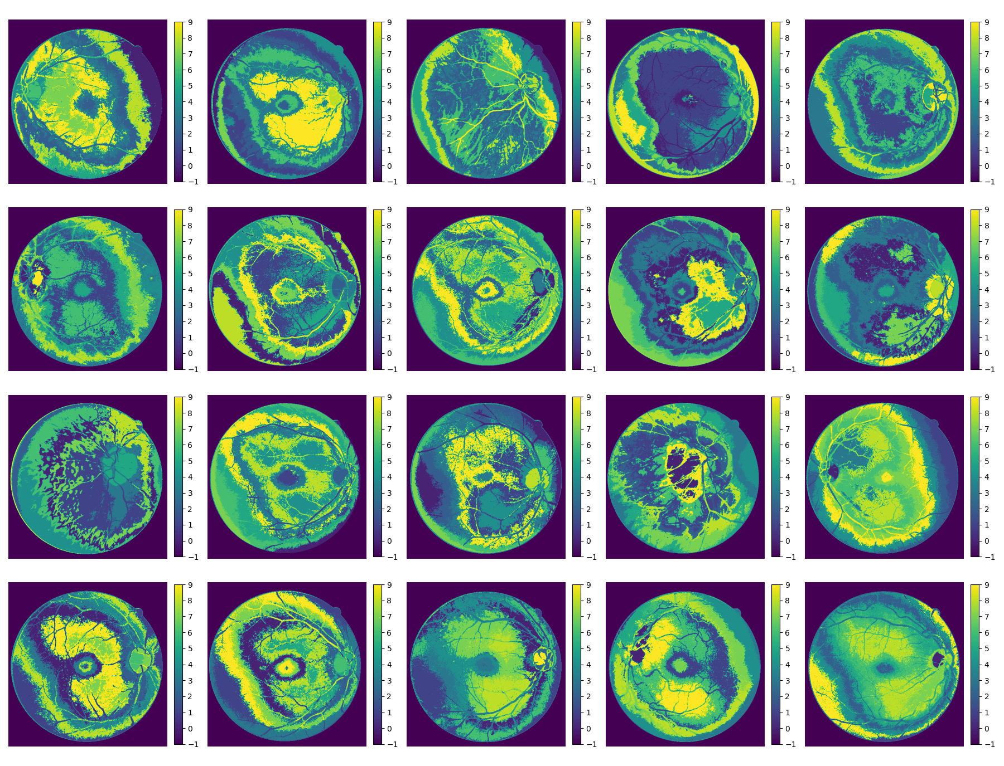

Slide 21
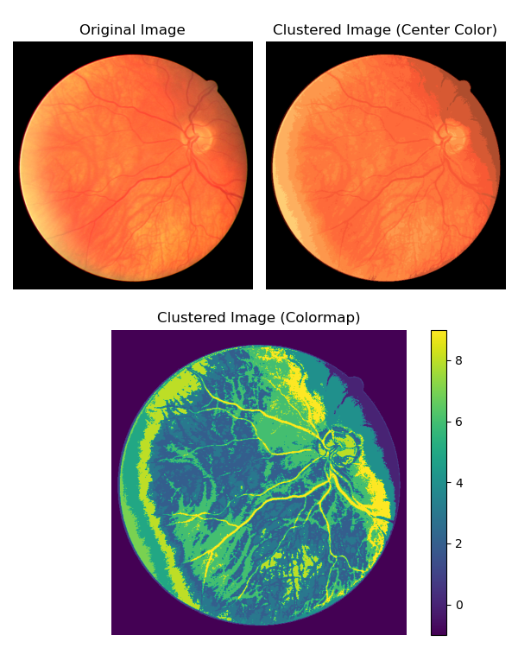

Slide 22
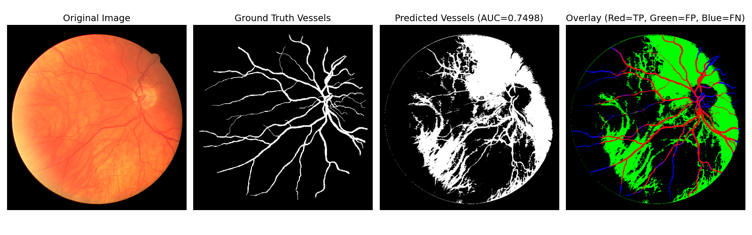
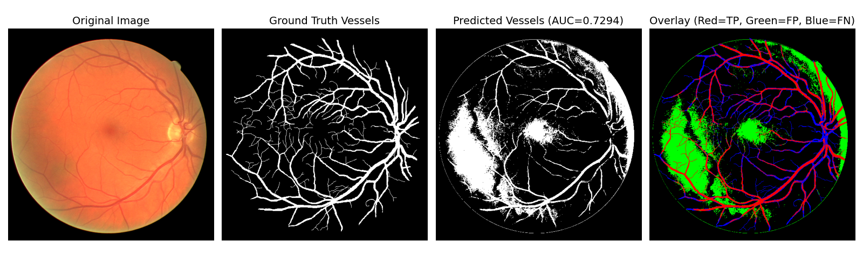
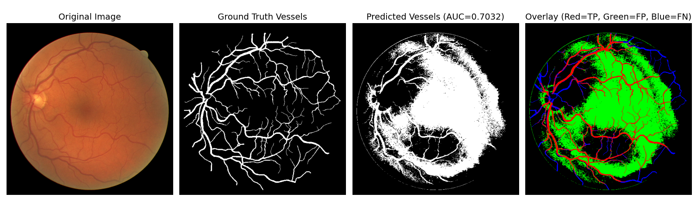
Optimized K-means Algorithm

Slide 23
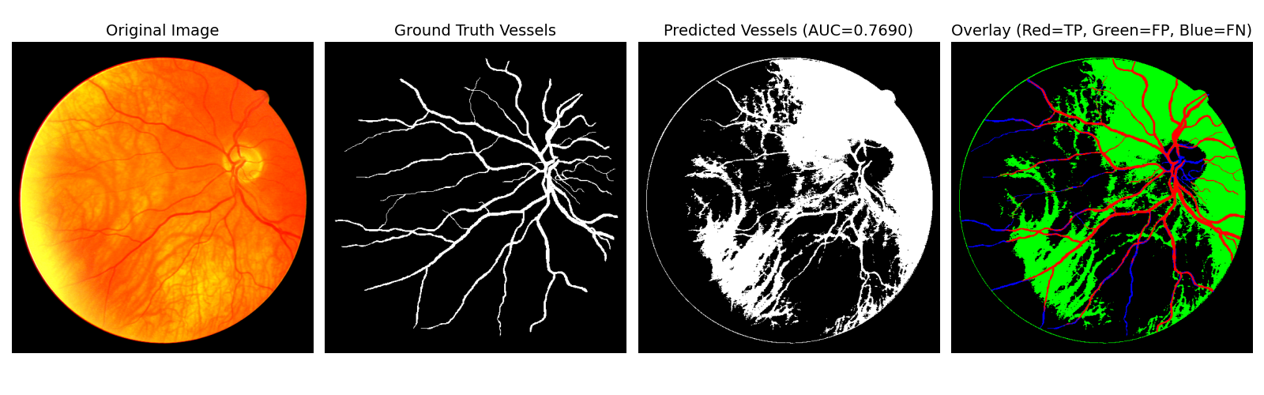
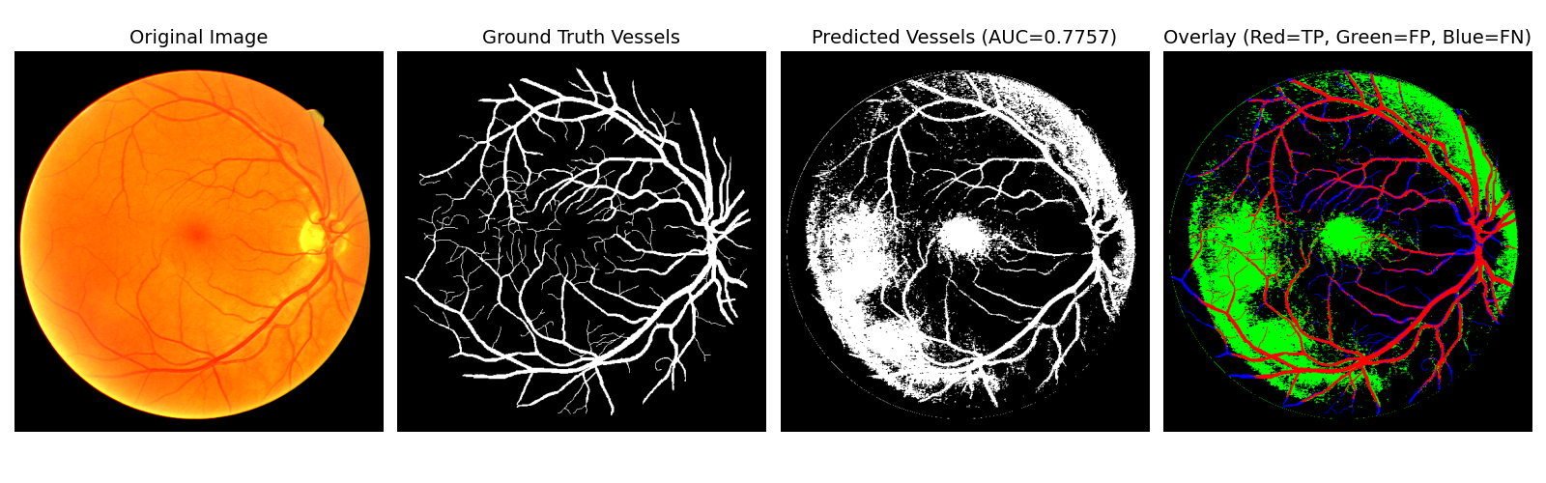
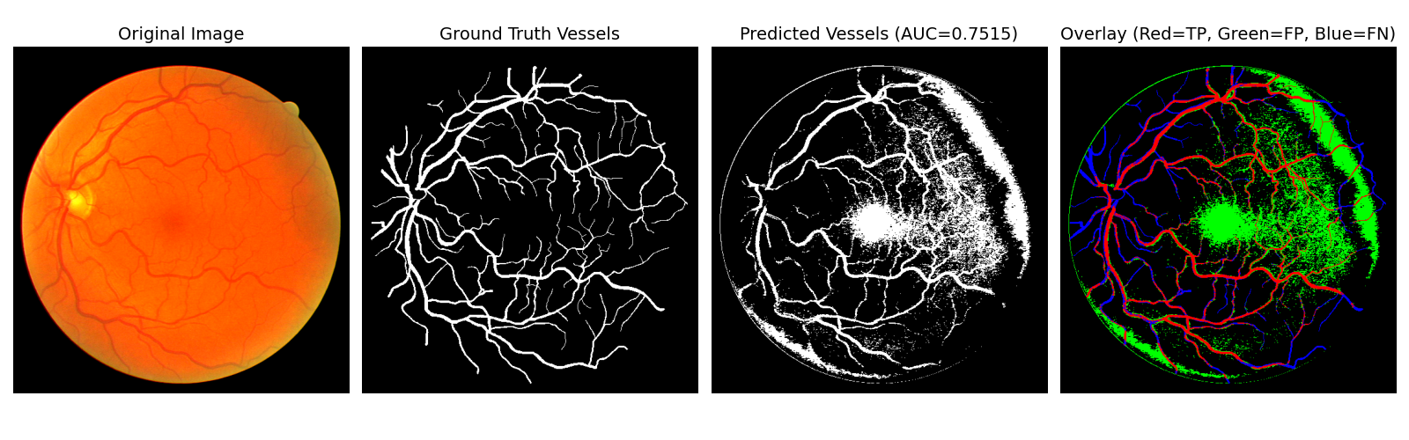
Optimized K-means Algorithm

Slide 24
Optimized K-means Algorithm

Slide 25
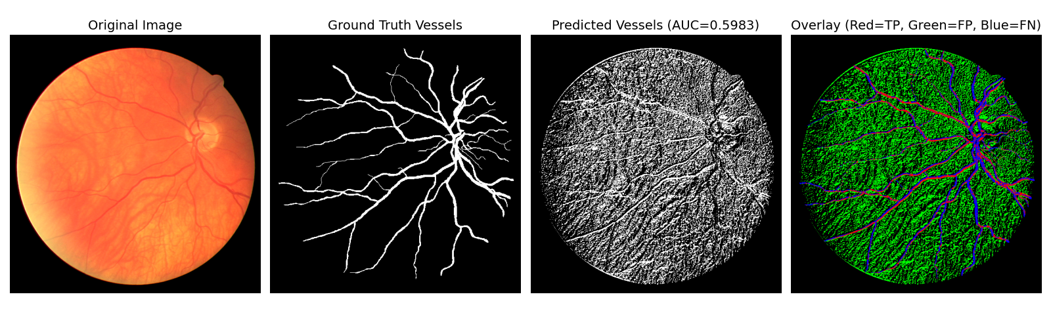
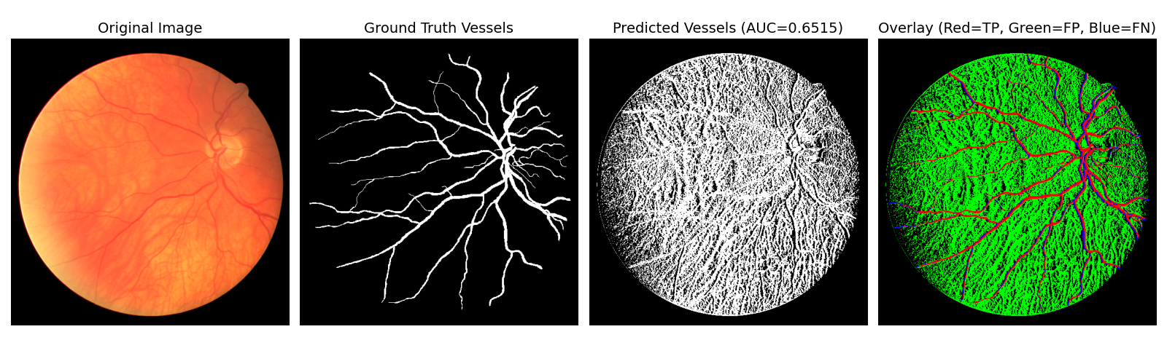
Direction-enhanced K-Means Clustering

Slide 26
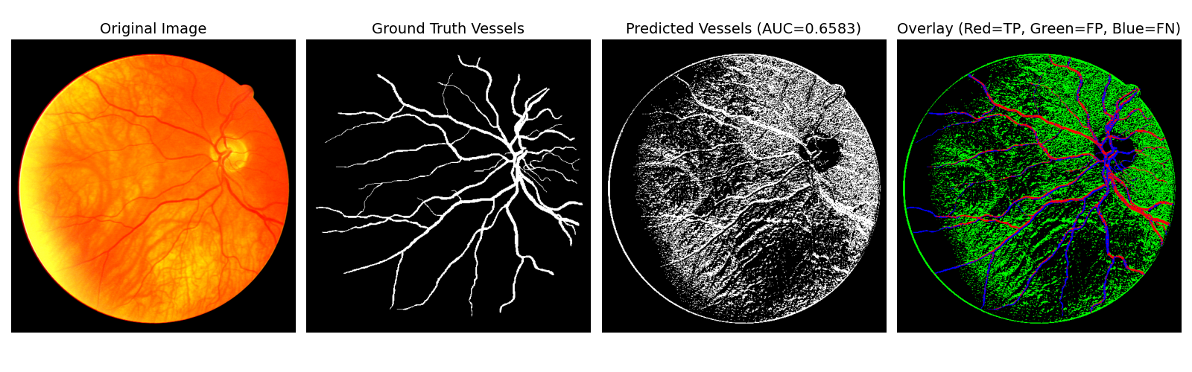
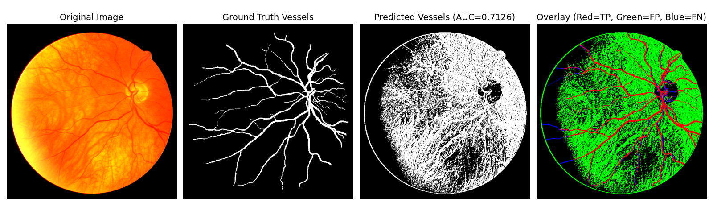
Direction-enhanced K-Means Clustering

Slide 27
4 Conclusion

Slide 28
TODO

